Slide 1
Demystifying the Medical School Admissions Process
Insider Scoop on a Competitive Application
Andrea G. Gonzalez
Admissions Counselor
Diversity & Inclusion Coordinator

Slide 2
Myths
Myths | Truths
“If I have a strong GPA and MCAT Scores, I am guaranteed admissions” | Grades and scores play a large role in your application but medical schools are also interested in who you are, why you want to be a physician, and whether or not you have a clue about what being a doctor is really like.
“I have to be a science major to get in” | You can major in any subject. It is important that you show your strengths in the science
“ I have to be in the toughest science major” | No matter how interesting or convenient a major is, do not choose it if it is too difficult for you.
“I must get into medical school right after I graduate” | It is common for many applicants to take gap year(s) to focus on strengthening application
“I am non traditional or career changer, its too late for me” | Showcase your life experiences and motivations that have lead you to find a new path into medicine
Notes:
Admissions committees will not cut you slack just because you majored in something difficult

Slide 3
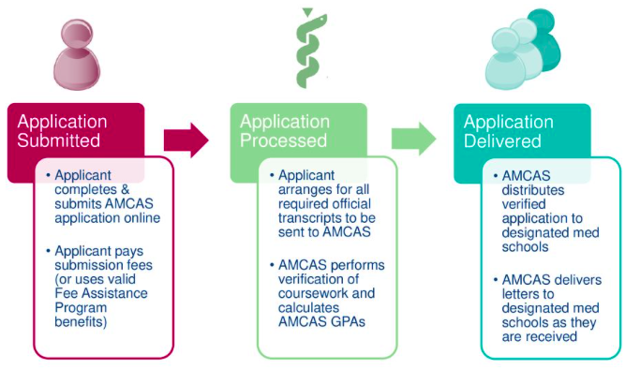
Where to Start
The Association of American Colleges (AAMC): https://www.aamc.org/students/
Provides resources for prospective students
How to apply
Costs
MCAT
MSAR-Medical School Admissions Requirements
American College Admissions Application Service (AMCAS)

Slide 4
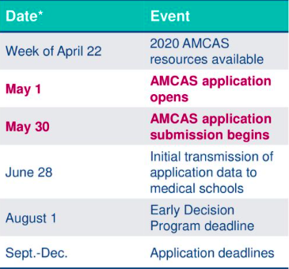
AMCAS Applications
APPLICANTS Applied through AMCAS
Approx. 53,371
APPLICANTS Matriculated
Approx. 21,869
TOTAL Medical Student Enrollment
Approx. 92,758
2020
*2019 AMCAS*
Notes:
-More applicants applying every year

Slide 5
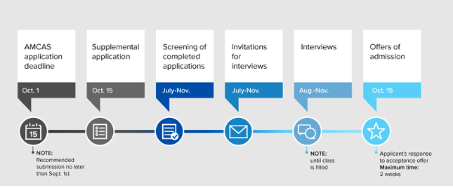
Application Process
Apply through AMCAS June 1-November 1
Submit official transcripts to AMCAS for verification (4-6 weeks)
Submit LOR to AMCAS for distribution to schools
Select schools to apply to
Complete Secondary Applications

Slide 6
Things to Think About
AMCAS Fee’s $160/ $39 / Secondary Fees Travel and Lodging Costs
How many schools to apply to?
Where to apply?
When to take the MCAT? How many times?
When to apply?
Will I be taking (a) gap year(s)
What if I applied and was rejected?
Can I apply again?
Notes:
Consider all the schools you would be interested in applying to
It is highly recommended to cast a wide net to ensure you are not limiting yourself opportunities
Take the MCAT when you are ready. It is HIGHLY recommended to not take it no more than 3 times. So it is important to space them out and really prepare for them before attempting retakes
Apply when you feel comfortable with all aspects of your application. It is very common to take GAPS to focus on ways to improve
Being a reapplicant is not a bad thing, it is very common for many applicants to be reapps if they did not make it the first time. A recommendation would be to evaluate your application and have someone else evaluate. Draw conclusions on areas that you can work on or more ways to stand out. Many Admissions Committee members will see that you are a applicant and wonder what you did differently from the previous app.

Slide 7
Joint Statement from California Medical Schools Regarding Academic Work and MCAT Tests that are Affected by the COVID-19 Outbreak
Applicants for the upcoming application cycle can count on our common commitment to the following principles:
Pass/Fail Grades
Our schools will accept pass/fail grades, without prejudice, for courses taken during the COVID-19 pandemic. It has always been our practice to consider grades in the context of numerous other aspects of the application, and an international crisis certainly provides a unique and compelling context. In making this statement, we are cognizant of the fact that some undergraduate schools are providing an option for students to take courses either for grades or on a Pass/Fail basis. We therefore want to be explicit that applicants should not feel pressured by us to choose the graded option. Students and their families are facing many challenges at the moment – maybe even life and death challenges. The pressure for grades need not be one of them.
MCAT Tests
We will accept applications from individuals who were unable to take the MCAT due to COVID-related test cancellations. For these candidates, we will base secondary application decisions on the information that is available to us at the time of the application. Assuming that MCAT testing resumes prior to October, we will require applicants to have taken the MCAT before we make admissions decisions for the Class of 2025. Accordingly, applicants should not delay applying simply because an MCAT score is not yet available.

Slide 8
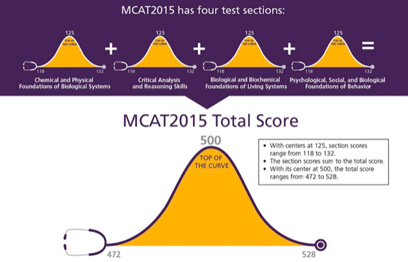
MCAT
Medical College Admissions Test (MCAT): https://www.aamc.org/students/applying/mcat/
Considerations:
Preparation Time and Cost
MCAT: $315/$125 (FAP)
Fee assistance program
30-35 days for score release
AMCAS App Fee$170 (1st school) + $40 beyond
Preparation
Kahn Academy (Free Online)
Free Online Practice Tests
Prep Courses ($$)
Notes:
LSAT Preparation can help with preparation for CARS Portion.
Recommend to NOT take MCAT more than 3 times. Ideally you would take it maximum of two times

Slide 9
Matriculants
MCAT
GPA
MCAT – 511
CARS – 128
CPBS - 127
BBLS - 128
PSBB – 128
GPA
Science – 3.65
Non-Science – 3.80
Cumulative – 3.72
UC Irvine Fall 2018 Class
MCAT – 514
CARS – 128
CPBS - 128
BBLS - 129
PSBB – 129
GPA
CUM – 3.78
BCPM – 3.76
Notes:
Everyone loves numbers! I have provided a snapshot of 2018 AAMC Applicants
These are the average numbers for all applicants who MATRICULATED in 2018.
To provide an example, I have also provided our incoming class average for matriculated student for our Fall 2018 incoming class

Slide 10
Academic Background
Science GPA vs. Cumulative GPA
Science (BCPM)
Biology, Chemistry, Physics and Math GPA
Cumulative GPA
Major
Show a strong foundation of science courses
Academic Patterns
Gap Year(s)
Classes after Undergraduate Degree
Postbaccalaureate Program vs Master’s Program
Notes:
There is two different GPA’s to be mindful of:
Science GPA
Cumulative GPA
The GPA’s will be evaluated by the Admissions Committee for all of the courses you took in a post-secondary institution. It will calculate any courses taken at a community college, 4 year university and any post-back undergraduate courses.
Undergraduate Courses from an accredited U.S institution will get evaluated together.
If you are looking ways to improve your GPA, the best route is find a postbacc program that takes courses at the undergraduate level. Graduate Courses from a Master’s or Ph.D. program will not assist your Undergraduate GPA but create a separate graduate GPA.
UC Consortium
It is a great postbaccaluerate program for those who need to help boost their undergraduate GPA
UC Davis, UC Riverside, UC Irvine, UC Los Angeles, and UC San Francisco have postbacc programs for those who need academic enhancements. Each institution vary in minimum admissions requirements but one common requirement is that the applicant but be considered disadvantaged.

Slide 11
Activities
Experience | Examples
Research | Wet Labs, Social Research, Individual Research
Clinical | EMT, CNA, Shadowing, Scribing, direct patient interaction
Community Service | Local Shelters, nonprofit organizations, service done through campus organizations
Extracurricular Activities | Sports, Hobbies, Chorus Practice, Art, Editor, Etc.
Work Experiences | Jobs do not need to be related to medicine
Life Experience | Unique life experiences such as non-traditional, 1st generation, personal or financial hardships, Leadership roles
Notes:
When you are ready to apply, sit down and think of all the experiences that you have accomplished since graduating high school
Consider your involvement in all of the areas
Research experience can be either wet lab research, social research, individual research, or even a combination of clinical research

Slide 12
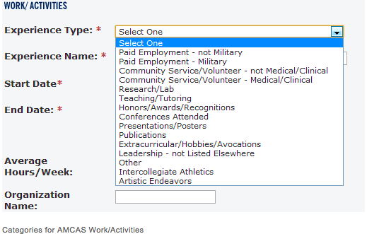
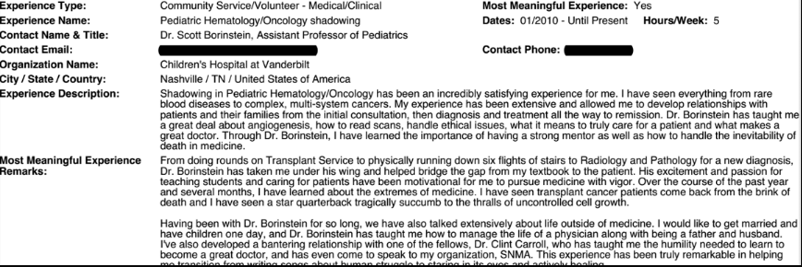
Activities
Things to consider:
What experiences to write about?
When to start counting?
Longevity
Quality vs. Quantity of Activities
Hours
Describing experiences
Notes:
Admissions Committee begin reviewing any experiences after graduating high school.
It is important to have great a sense of longevity experiences to ensure that you were able to show your dedication to the work but also build a level of rapport to potentially receive letters of recommendation
The numbers of hours also does take into account with the length of experience.
Describing experiences are crucial
In experience, the description can be either too generic or lack explanation. It is important to describe the experience that you did on your AMCAS Application. Not only what it was but what you specifically did in this role.
What experiences should I write about?
Rule #1: Did it have an impact on growing you as an individual? If yes, write about it. If no, move on.
Rule #2: It does not have to be medically related.
Rule #3: You should be able to comfortably talk about it in an interview.
Intro: what specifically was your role?
Body: The middle few sentences should tell why this experience was important to you.
Conclusion: concluding sentence should say why it was important to you in your growth and development as a future doctor.

Slide 13
Letters of Recommendation
Who is the writer?
Science professors vs. other professors?
Research mentor/principal investigator
Clinical mentor
Coach
Supervisor
Who else?
How to select?
How to get the best letter of recommendation?
Notes:
It is important to build a rapport with individuals who can write letters of recommendations
From faculty who you worked with and faculty you have taken classes with
Avoid common mistakes about asking last minute and the letters of recommendation being too generic
The purpose for these LOR’s is to get a better understanding of who you are
Many writers simply rewrite your resume in a letter format and it becomes to generic. Nothing personal for the admissions committee to see
Also be VERY mindful of those who you are selecting to write a letter of recommendation on your behalf
Do not use roommates, friends, etc.
Do not use someone who you did not have a positive rapport, it comes out in those letters

Slide 14
Personal Statement
What to write about?
What should the message be?
Sample Topics: An experience that changed or challenged your perspective about pursuing a
career in medicine A challenging or transformative
personal experience A summation of your academic, research, volunteer, and or clinical experience/exposure.
Notes:
Personal statement is one of the best ways to stand out from other applicants
This personal statement will reflect your life experiences and why you chose medicine.
Have fun with your writing and make sure you have people proof reading it

Slide 15
Common Mistakes
Using an inactive email address
Rushing through the secondary applications
Taking too long to send back your secondary applications
Sending applications without proof reading
Traveling to a remote location during the interview season
Asking for letters of recommendation too late
Not researching the schools you are applying to
Notes:
I HIGHLY recommend to create a separate GMAIL Account for your Admissions Items
It is very common for students to use their “school” email account and then once they graduate, emails start bouncing and then they do not receive their updates
GMAIL Accounts are FREEEEE!! Make one, and possibly a nice email address
Once your submit your AMCAS Application, be ready for any updates, invites, etc. Check also your junk/spam folders which sometimes these emails get stuck in.
Since many applicants do not check their emails often, their invites to complete secondary get “lost” and delay the process of submitting your secondary and having your application reviewed. The initial stages all begin with email communication so recommended check the very least once a week
Additionally, those who are very excited as you should be, make very common grammatical mistakes, or enter the wrong information. As a reminder your applications are the first impressions for the Admissions Committee, so it is important to showcase your best. Have a friend or family review it before officially sending the “submit” button
It is common to continue your experiences during the application cycle. However, when students leave the country to continue studying, research, or other extracurricular activities, they are limited themse4lves to small windows. As I mentioned, you would need to travel and visit the institutions if you are invited for an interview, and the days/times but not be as convenient like always on a Monday or a Friday, but rather a Tuesday, Wednesday, or Thursday. It is great that you are gaining these meaningful experiences but you are placing yourself in situations that might make it difficult for you to attend and resulting in withdrawals.
Once your AMCAS Application has been verified, institutions are notified and primary applications will begin reviewing. However, if you do not have your letters of recommendations, it is commonly possible that your application stays on hold until letters of recommendation are collected. Remember to contact them early so once they receive the link to complete an LOR they will not take as long.
Many medical schools are on rolling admissions, and the further your delay can affect your potential review.

Slide 16
Final Thoughts
Apply only when YOU
are ready!!!!

Slide 17
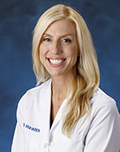
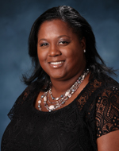
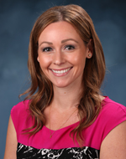
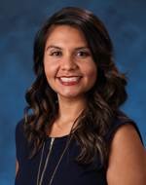
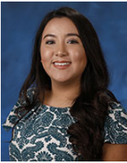
UC Irvine Office of Admissions
949-824-5388
medadmit@uci.edu
www.meded.uci.edu/admissions
UC Irvine School of Medicine Admissions Team

